Slide 1

EDA Project 2

Slide 2
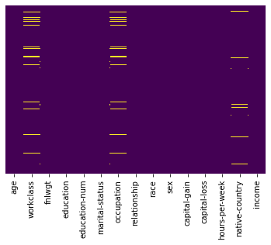
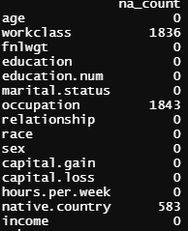
NA values

Slide 3

Dropping NA
Dropping NA’s will not greatly impact size of dataset.
New file was saved as cleandata

Slide 4
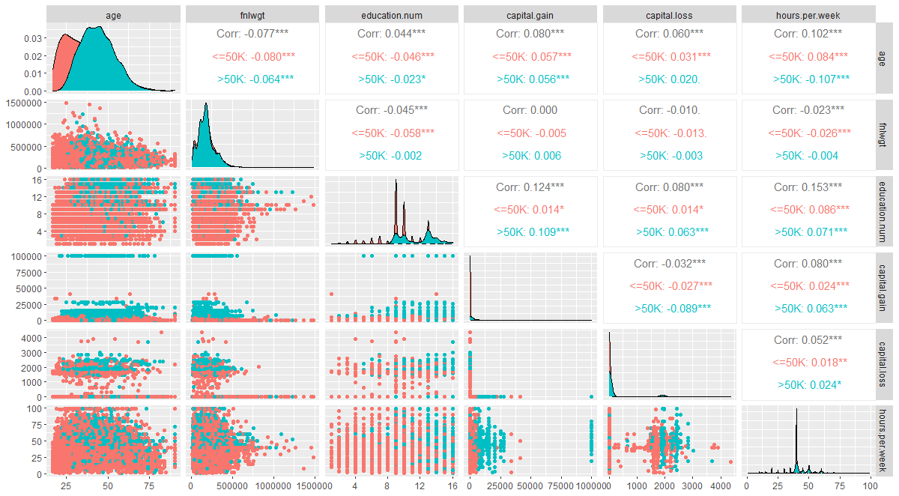

Slide 5
Scatterplot conclusions
Low VIF
Clear clustering Hours.per.Week, Education.number, Capital Gains and Capital Loss seem to show most clustering.
Suggestion for feature selection would be those 4 and age.

Slide 6
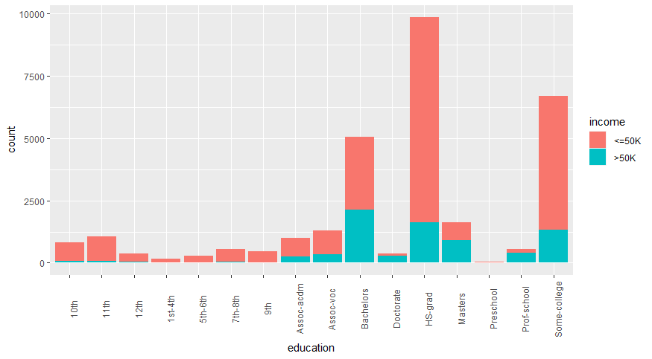
Categorical : Education
Notes: Clear earnings increase starting with associate degree

Slide 7
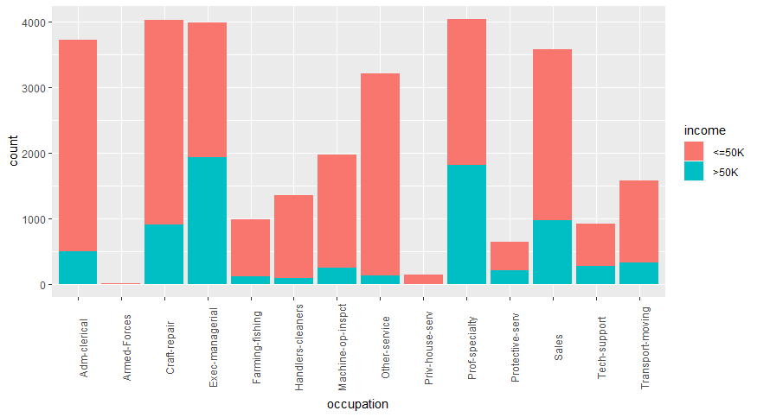
Categorical : occupation
Notes: Executive and prof-specialty show highest groupings, craft-repair, and sales also promising

Slide 8
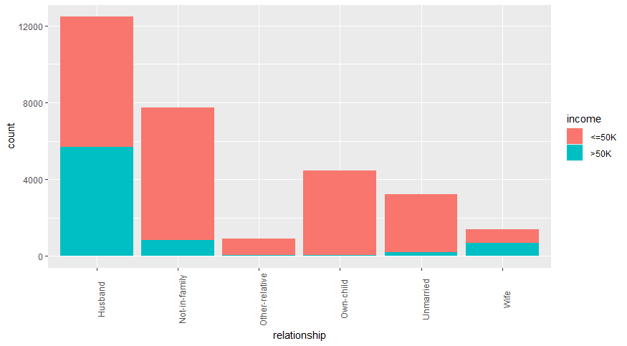
Categorical : Relationship
Notes: Husband shows best promise for bayes statistic

Slide 9
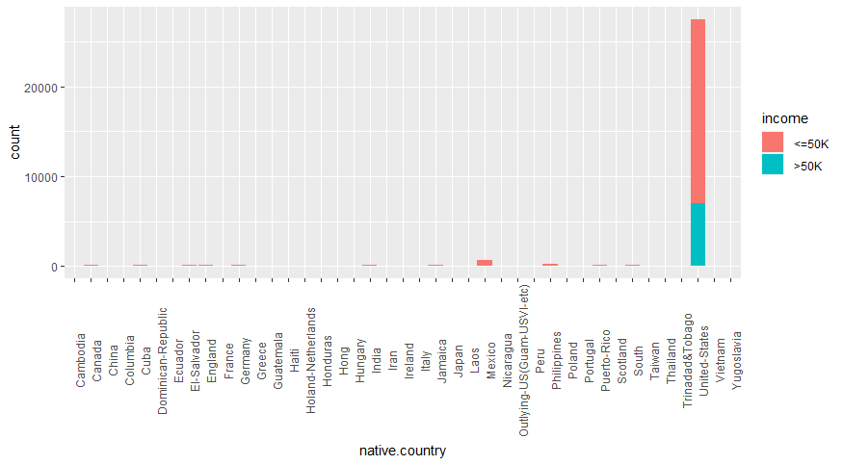
Categorical : Native Country
Notes: This one is pretty worthless

Slide 10
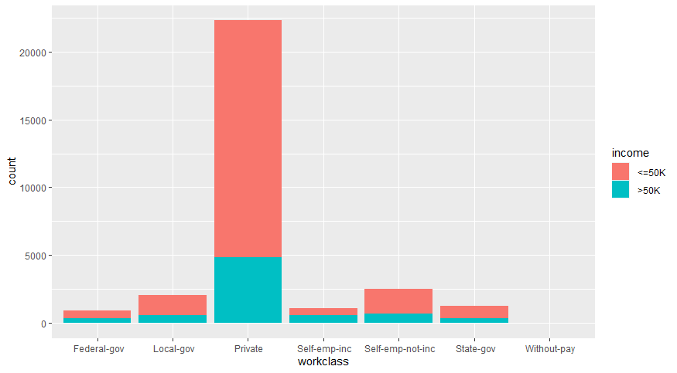
Categorical : workclass
Notes: Private is most promising but can probably skip this one as well

Slide 11
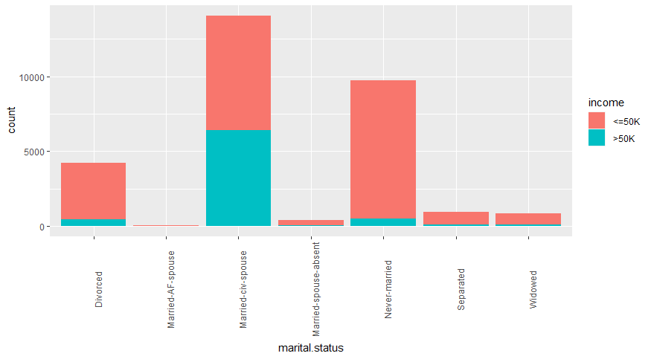
Categorical : Marital Status
Notes: Clear grouping here on almost all statuses

Slide 12
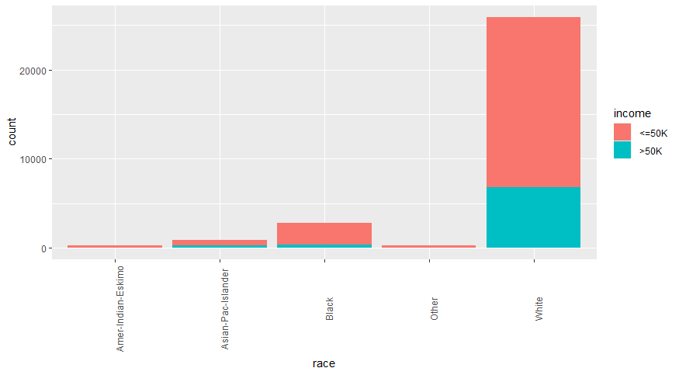
Categorical : Race
Notes: White has largest grouping, possibly useful.

Slide 13
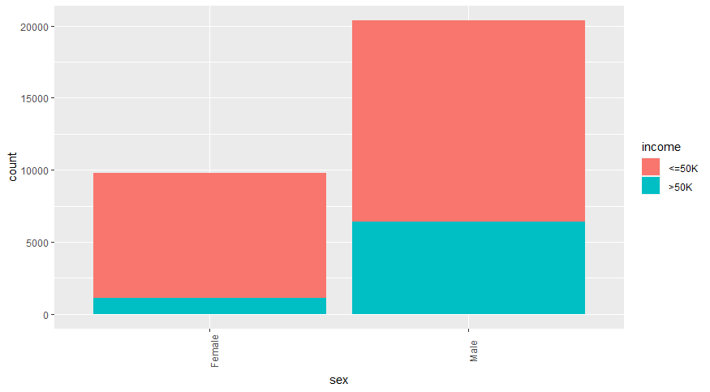
Categorical : Sex
Notes: Some significant difference between populations. Should most likely be included

Slide 14
Categorical Conclusions
Education or Education level are the same more or less, Education might be the easier for interpretability. Or you could create a new column of college degree.
Relationship and Marital will be similar, think Marital should be used if anything
Categorical for Sex should probably be considered in model.

